Slide 1

Setting Data & ML Pipeline with GitHub Actions
Data Innovation Summit 2025
Rami Krispin, May 7th, 2025

Slide 2


Rami Krispin
Senior Manager - Data Science & Engineering
Author | Open Source | Docker Captain 🐳

Slide 3
Agenda
What GitHub Actions Is
Pipelines Architecture with GitHub Actions

Slide 4
Motivation

Slide 5


Slide 6
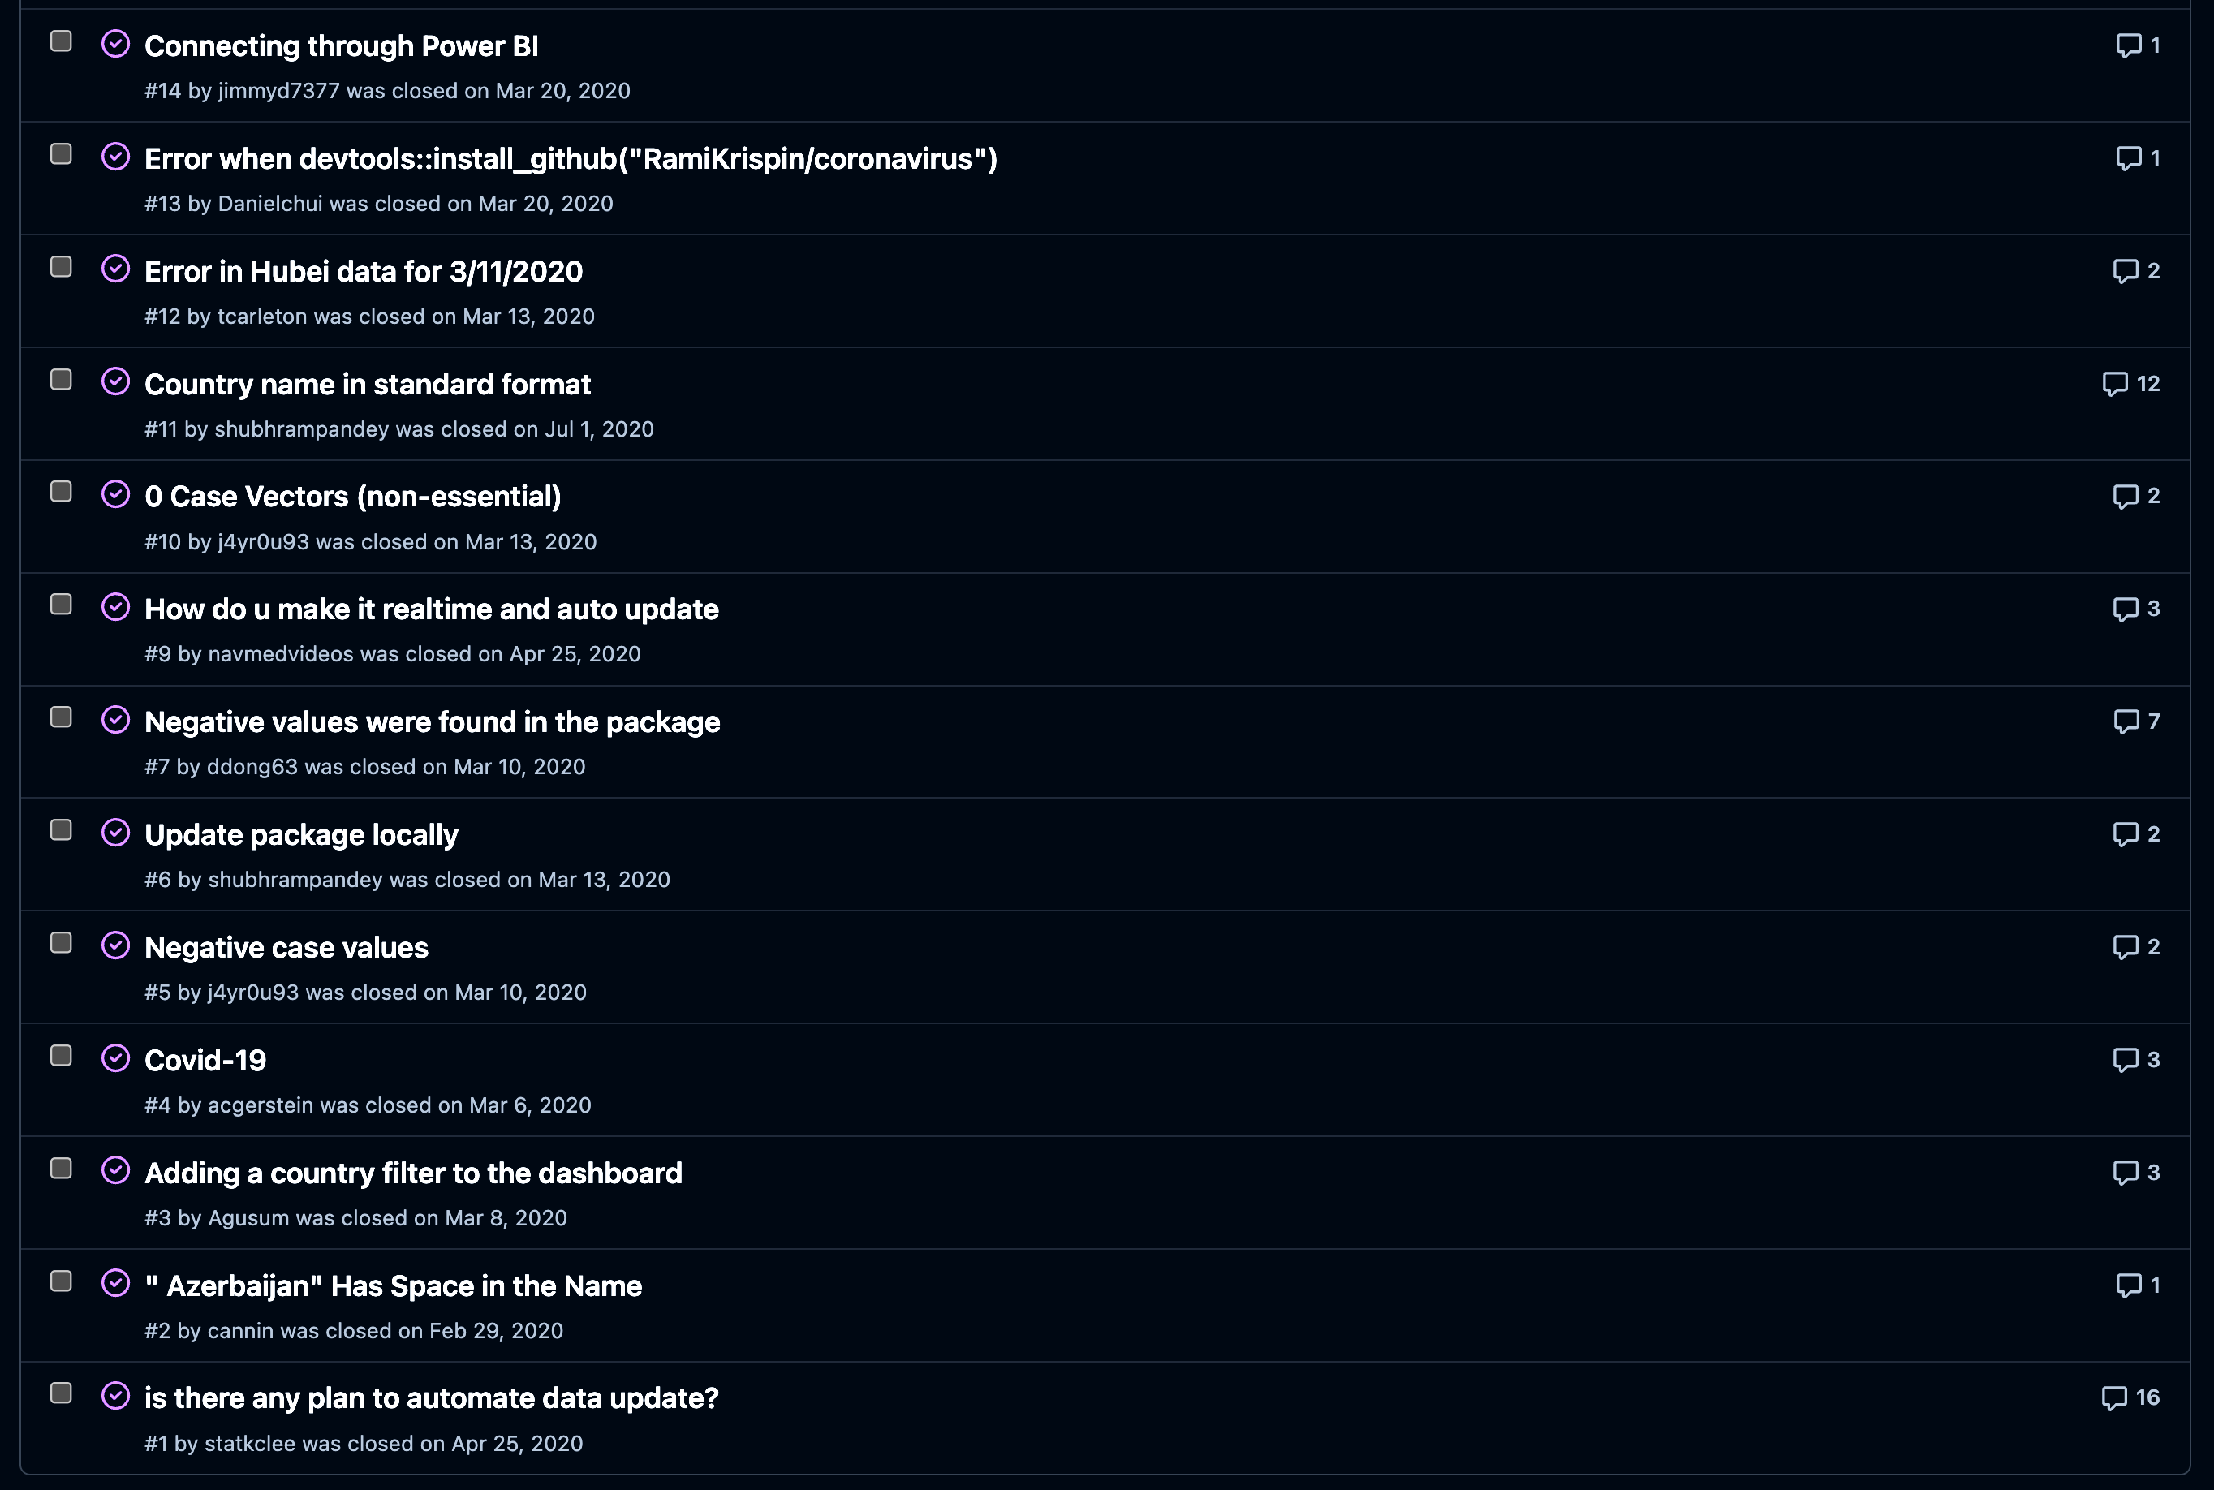

Slide 7


Slide 8
GitHub Actions

Slide 9
A Platform to Automate Workflows

Slide 10
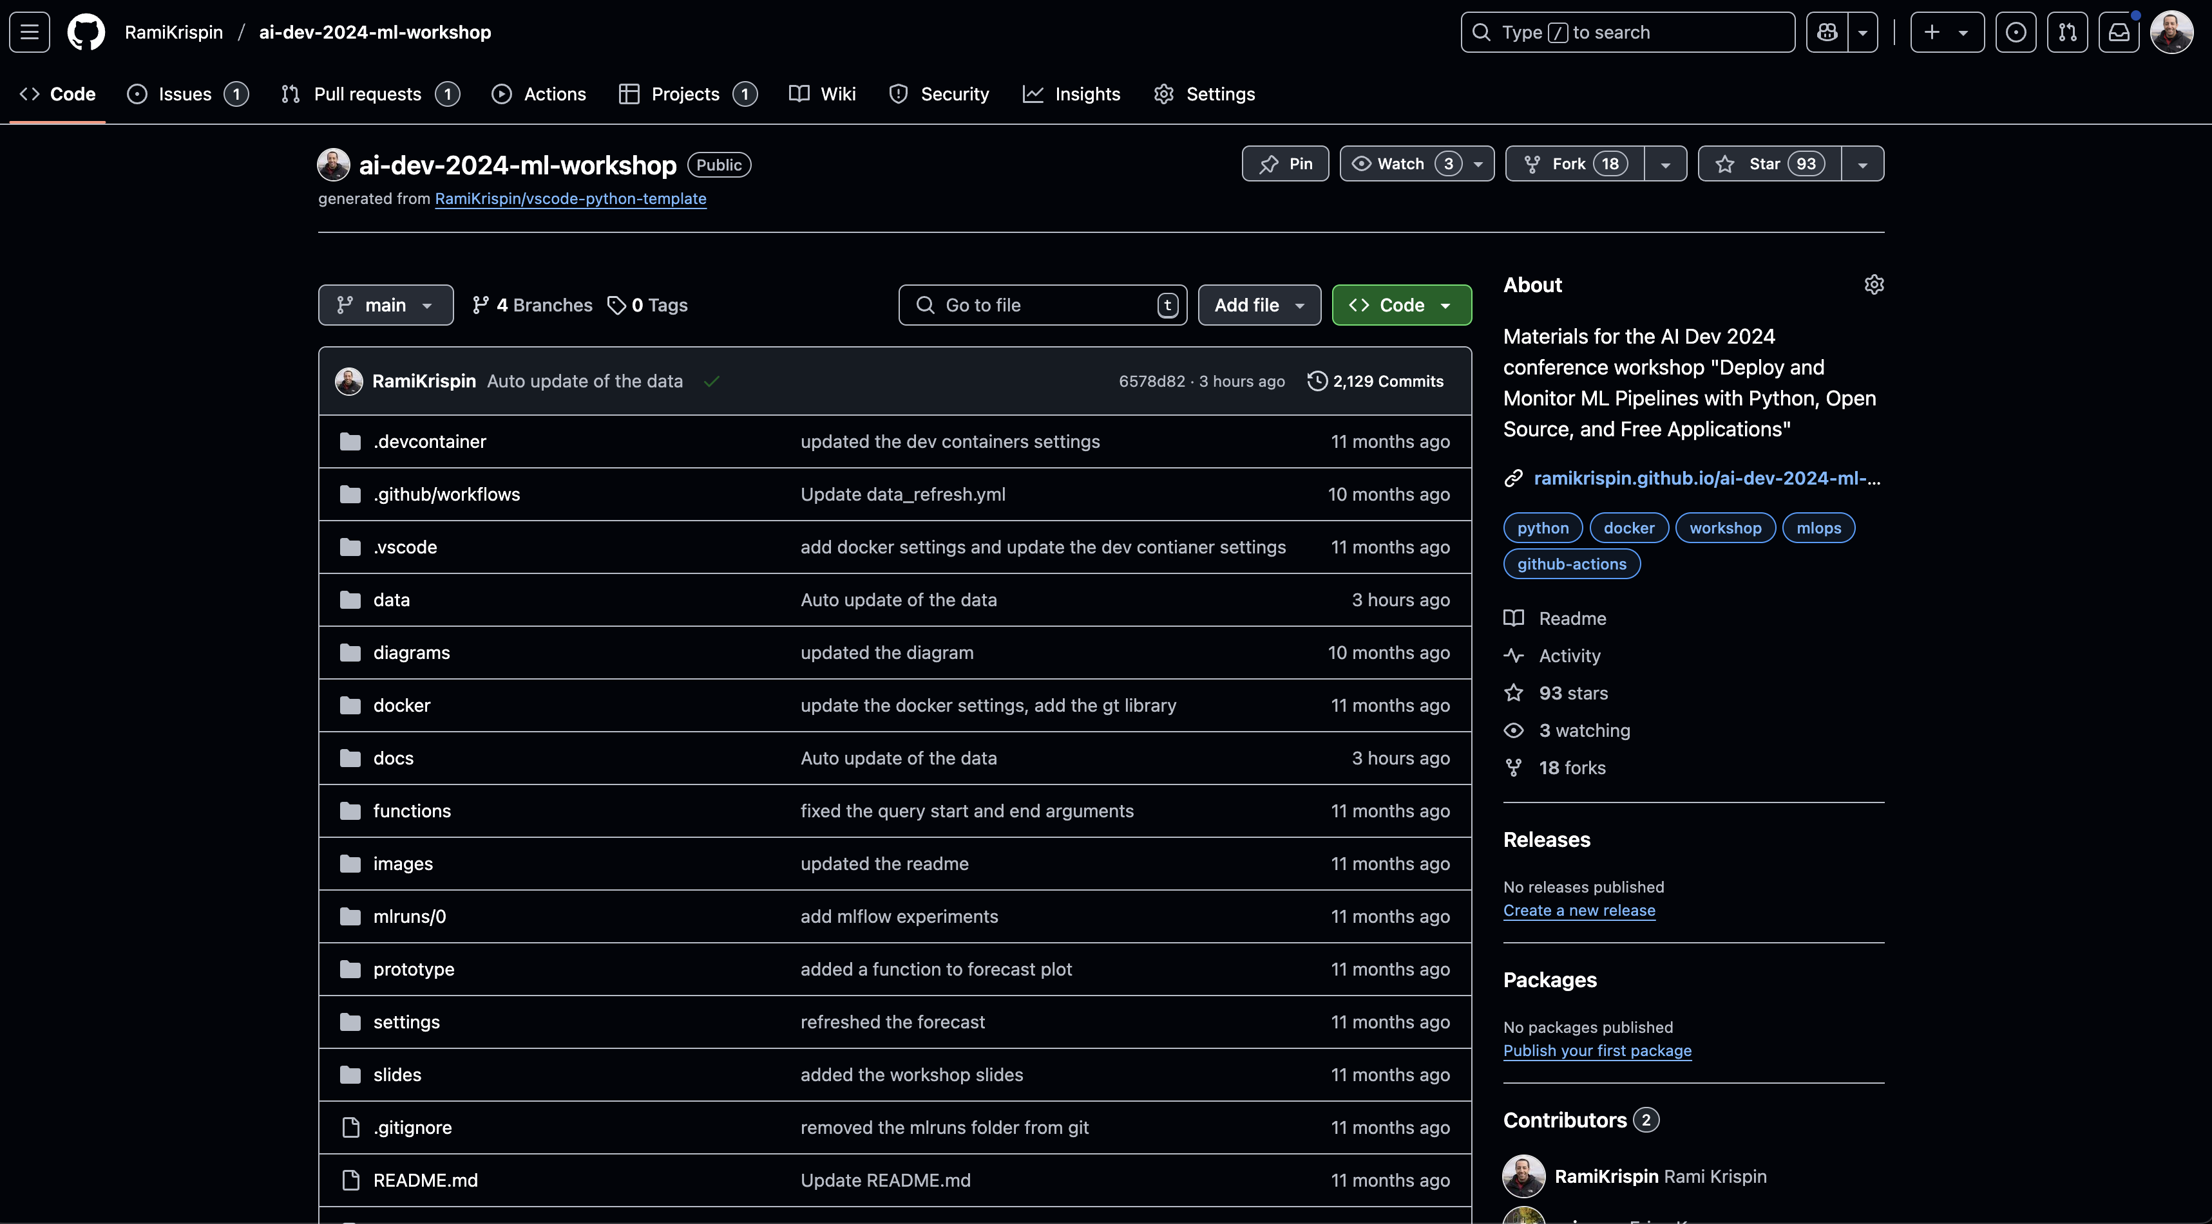

Slide 11
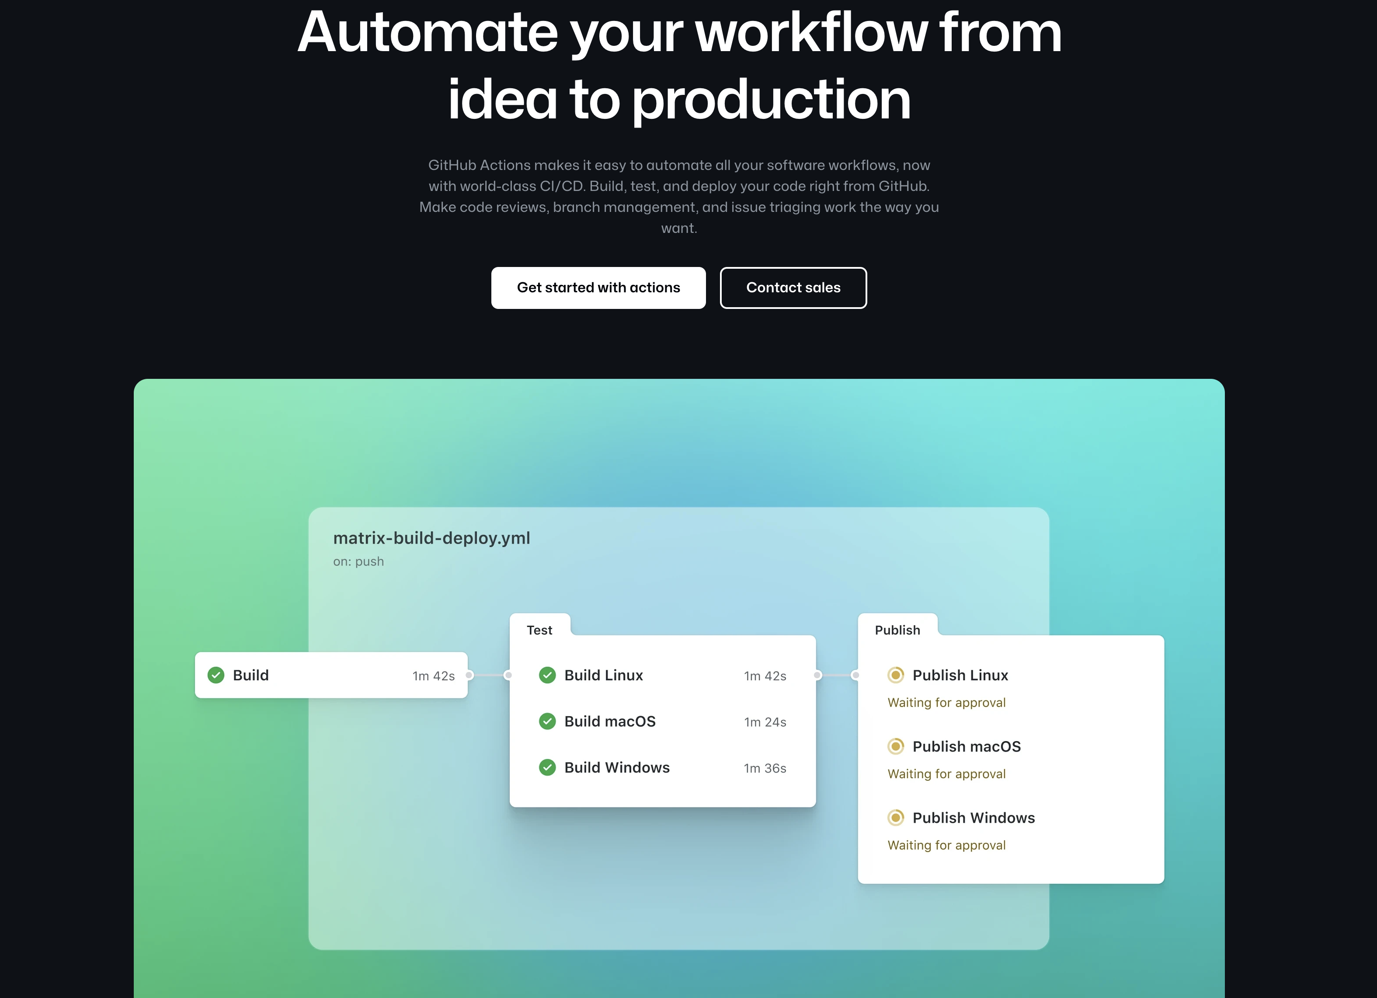
Workflow Automation
Unit testing
Code deployment
Matrix build
General purpose automation
Notes:
Workflow automation at the repository level

Slide 12
Workflow Types
Triggered
Scheduled

Slide 13


Triggered Workflow
Code Testing
Local
Remote

Slide 14
Triggered Workflow
Code Testing
git push
Local
Remote

Slide 15

Triggered Workflow
Code Testing
git push
Local
GitHub Actions
Remote

Slide 16
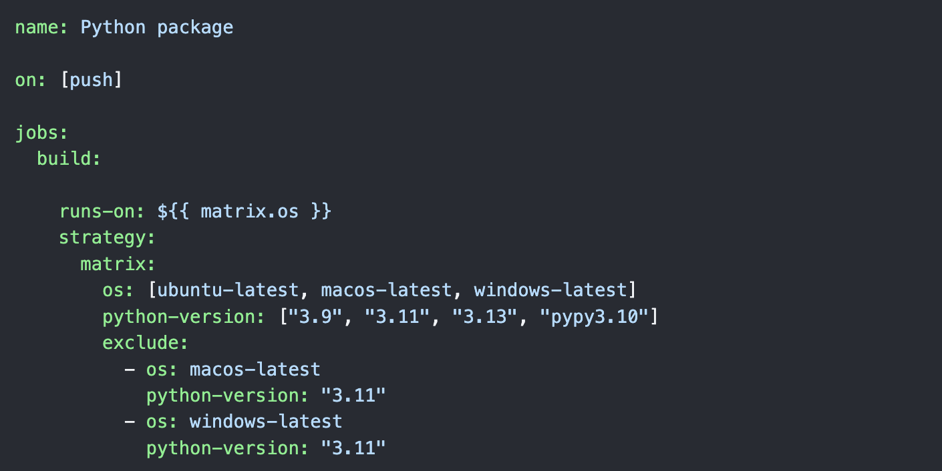
Source: GitHub Actions documentation

Slide 17
Source: GitHub Actions documentation

Slide 18
Source: GitHub Actions documentation

Slide 19
Source: GitHub Actions documentation

Slide 20
Source: GitHub Actions documentation

Slide 21
Source: GitHub Actions documentation

Slide 22
Triggered Workflow
Code Testing
git push
Local
GitHub Actions
Remote

Slide 23
Triggered Workflow
Code Testing
git push
Local
GitHub Actions
Remote

Slide 24
Triggered Workflow
Code Testing
git push
Local
GitHub Actions
Remote

Slide 25

Scheduled Workflow
Cron Job
0 */4 * * *
Local
GitHub Actions
Remote

Slide 26


Scheduled Workflow
Cron Job
Local
GitHub Actions
Remote
0 */4 * * *

Slide 27

Scheduled Workflow
Cron Job
0 */4 * * *
Environment
Script

Slide 28
GitHub Actions
Key Features
Multiple OS support
Docker support
Any language
Secrets
Logs

Slide 29
GitHub Actions
Pros vs. Cons
Out of the box
Scale
Ecosystem

Slide 30
GitHub Actions
Pros vs. Cons
Out of the box
Scale
Ecosystem
Streaming
Orchestration
Debugging

Slide 31
GitHub Actions
Pros vs. Cons
Forecasting
A Live Anomaly Detection

Slide 32
Data & ML Pipelines with Actions

Slide 33
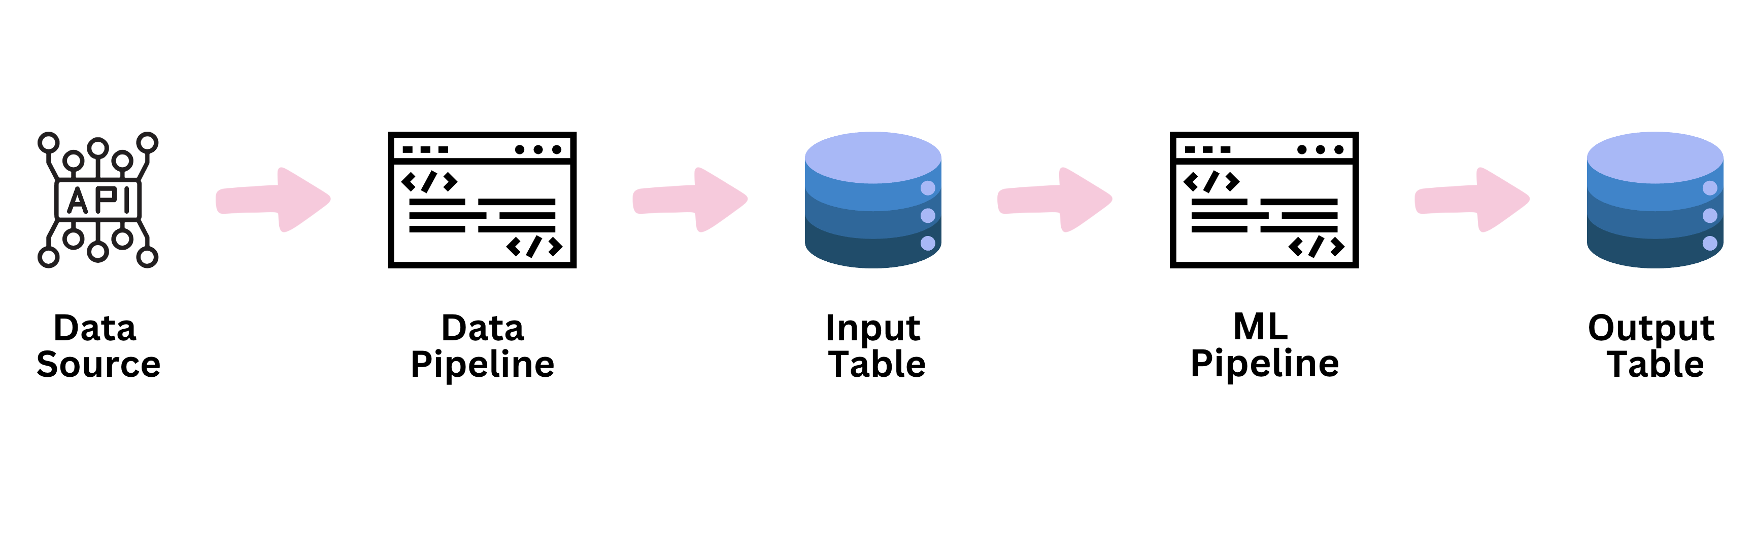
In a Nutshell
The Pipeline Components

Slide 34
In a Nutshell
The Pipeline Components
ETL
Feature engineering

Slide 35
In a Nutshell
The Pipeline Components
Refresh the model
Monitor

Slide 36
Forecasting the US Hourly Demand for Electricity

Slide 37
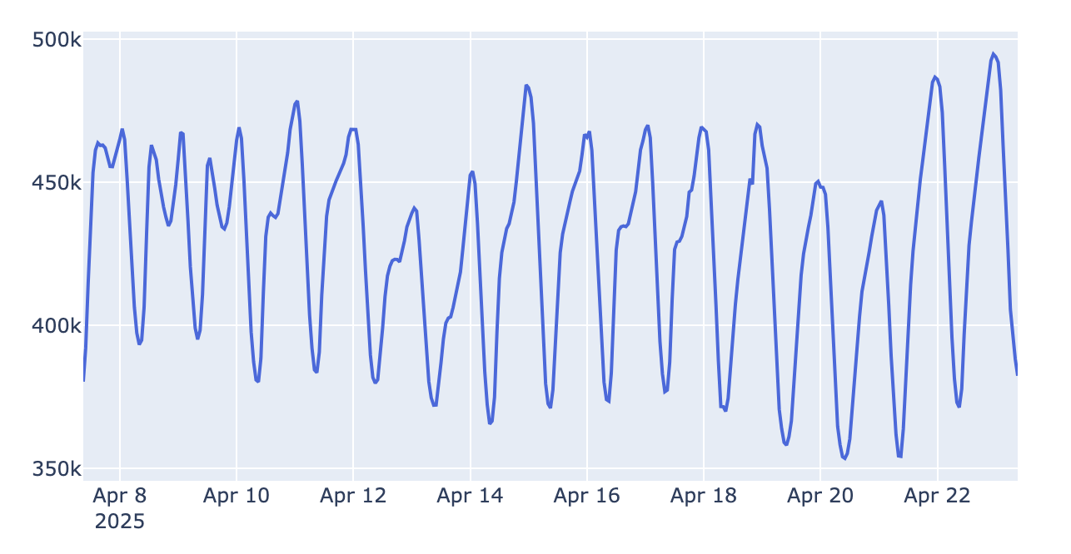
Forecasting the US Hourly Demand for Electricity

Slide 38
Forecasting the US Hourly Demand for Electricity
Scope
Refresh the data hourly
Create 72 hours forecast
Refresh the forecast every 24 hours

Slide 39
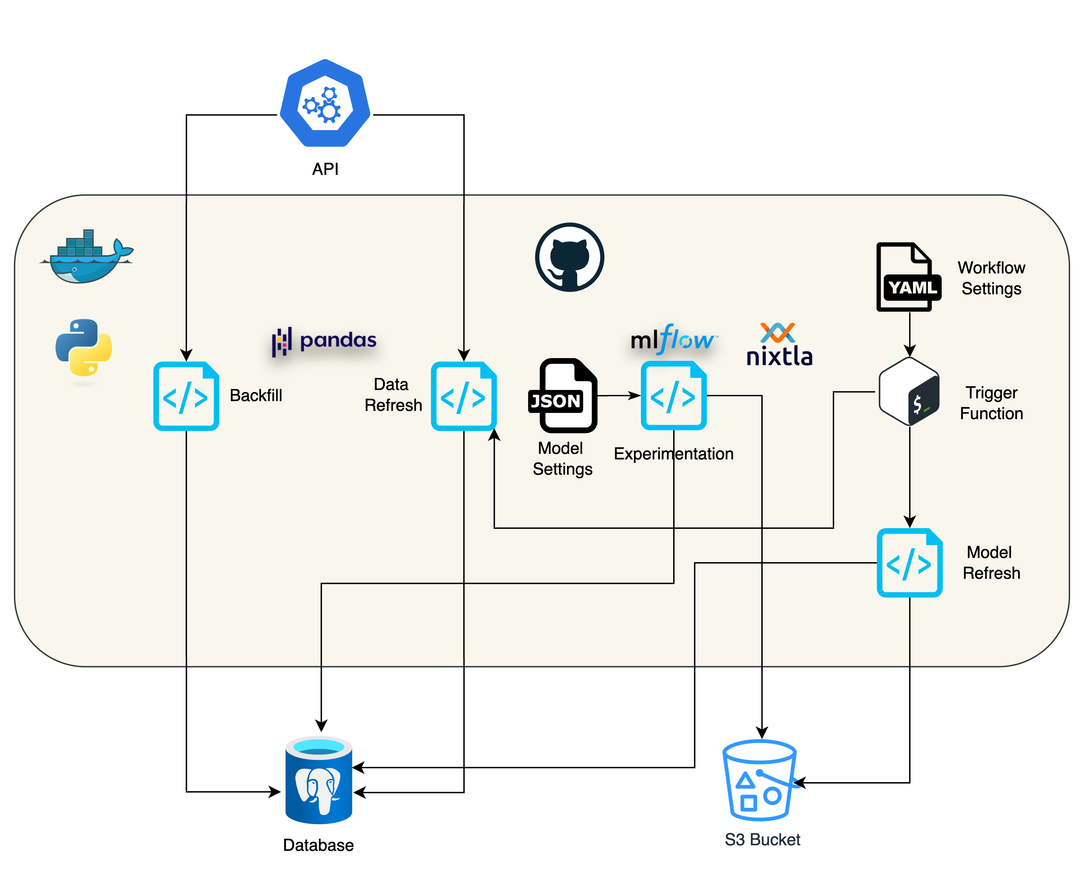
Data & ML Pipeline with GitHub Actions
Architecture
Local Repository

Slide 40
Data & ML Pipeline with GitHub Actions
Architecture
Local Repository

Slide 41
Data & ML Pipeline with GitHub Actions
Architecture
Local Repository

Slide 42
Data & ML Pipeline with GitHub Actions
Architecture
Local Repository

Slide 43
Data & ML Pipeline with GitHub Actions
Architecture
Local Repository

Slide 44
Data & ML Pipeline with GitHub Actions
Architecture
Local Repository

Slide 45
Data & ML Pipeline with GitHub Actions
Architecture
Local Repository

Slide 46
Data & ML Pipeline with GitHub Actions
Architecture
Local Repository

Slide 47
Data & ML Pipeline with GitHub Actions
Architecture
Local Repository

Slide 48
Data & ML Pipeline with GitHub Actions
Architecture
Local Repository

Slide 49
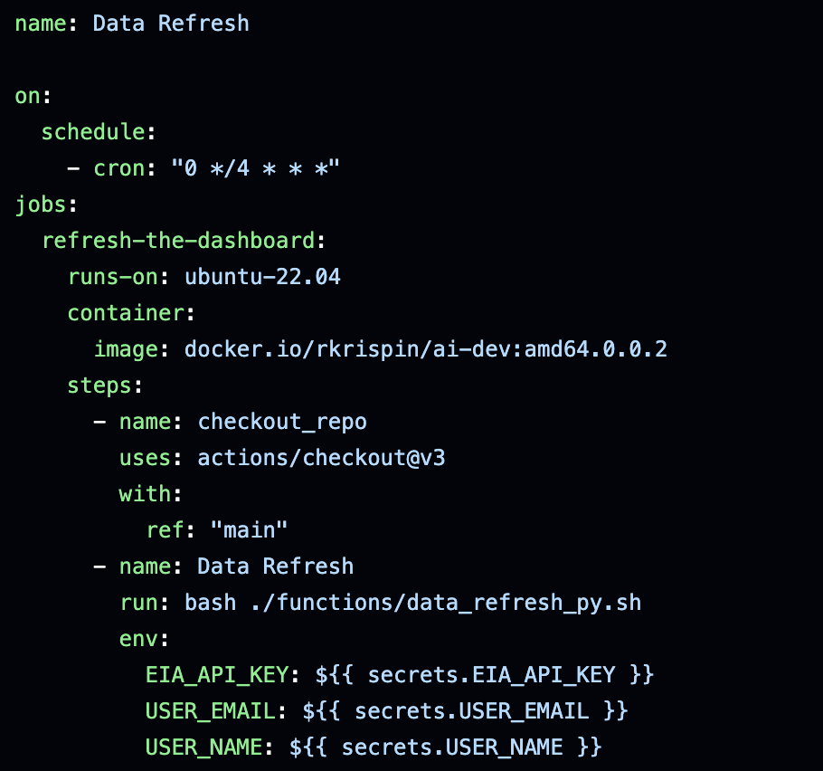
Data & ML Pipeline with GitHub Actions
Architecture
Local Repository

Slide 50
Data & ML Pipeline with GitHub Actions
Architecture
Local Repository

Slide 51
Data & ML Pipeline with GitHub Actions
Architecture
Local Repository

Slide 52
Data & ML Pipeline with GitHub Actions
Architecture
Local Repository

Slide 53
Data & ML Pipeline with GitHub Actions
Architecture
Local Repository

Slide 54
Data & ML Pipeline with GitHub Actions
Architecture
Local Repository

Slide 55
Data & ML Pipeline with GitHub Actions
Architecture
Local Repository

Slide 56
Data & ML Pipeline with GitHub Actions
Architecture
Local Repository

Slide 57
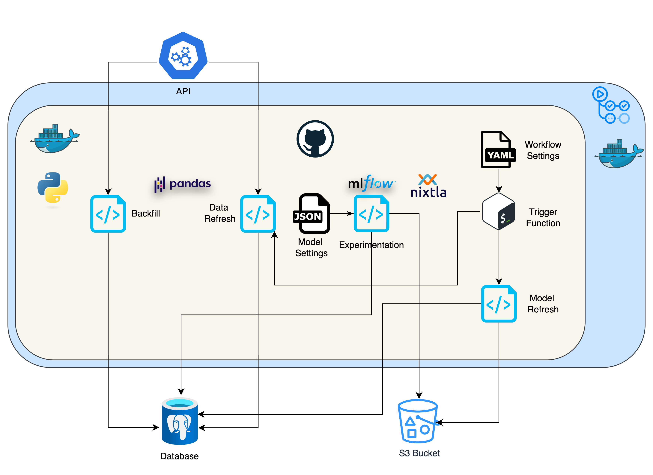
Data & ML Pipeline with GitHub Actions
Architecture
Remote Repository

Slide 58
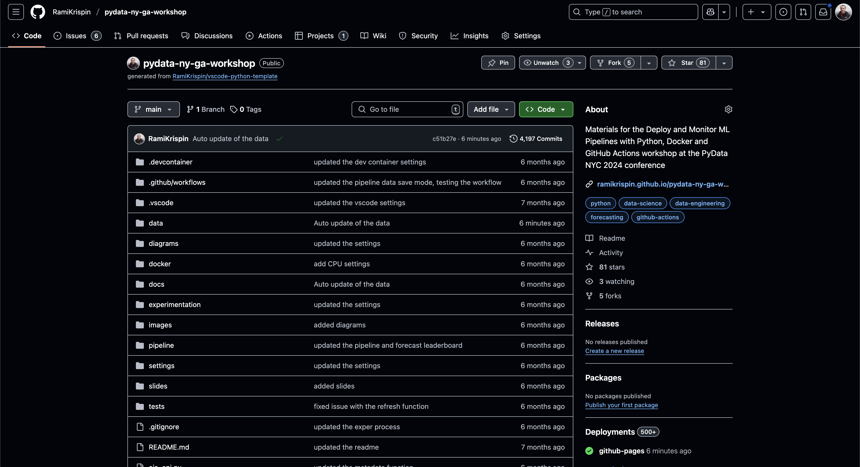
Data & ML Pipeline with GitHub Actions
Architecture
Remote Repository

Slide 59
Data & ML Pipeline with GitHub Actions
Architecture
Remote Repository

Slide 60
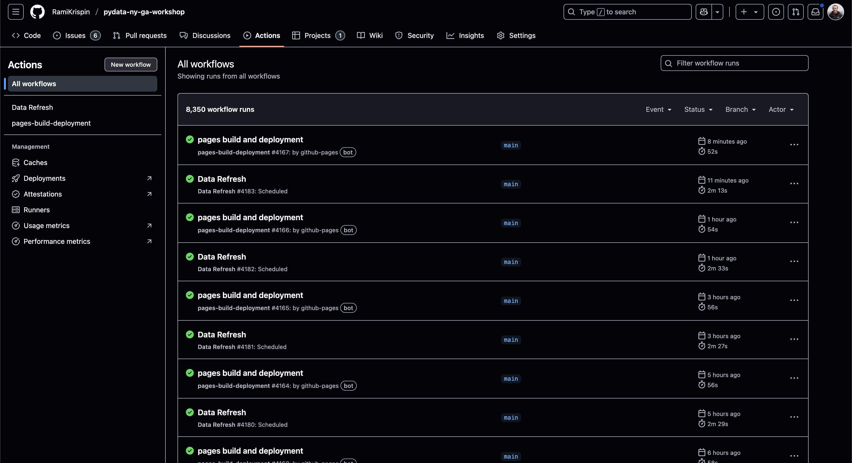
Data & ML Pipeline with GitHub Actions
Architecture
Remote Repository

Slide 61
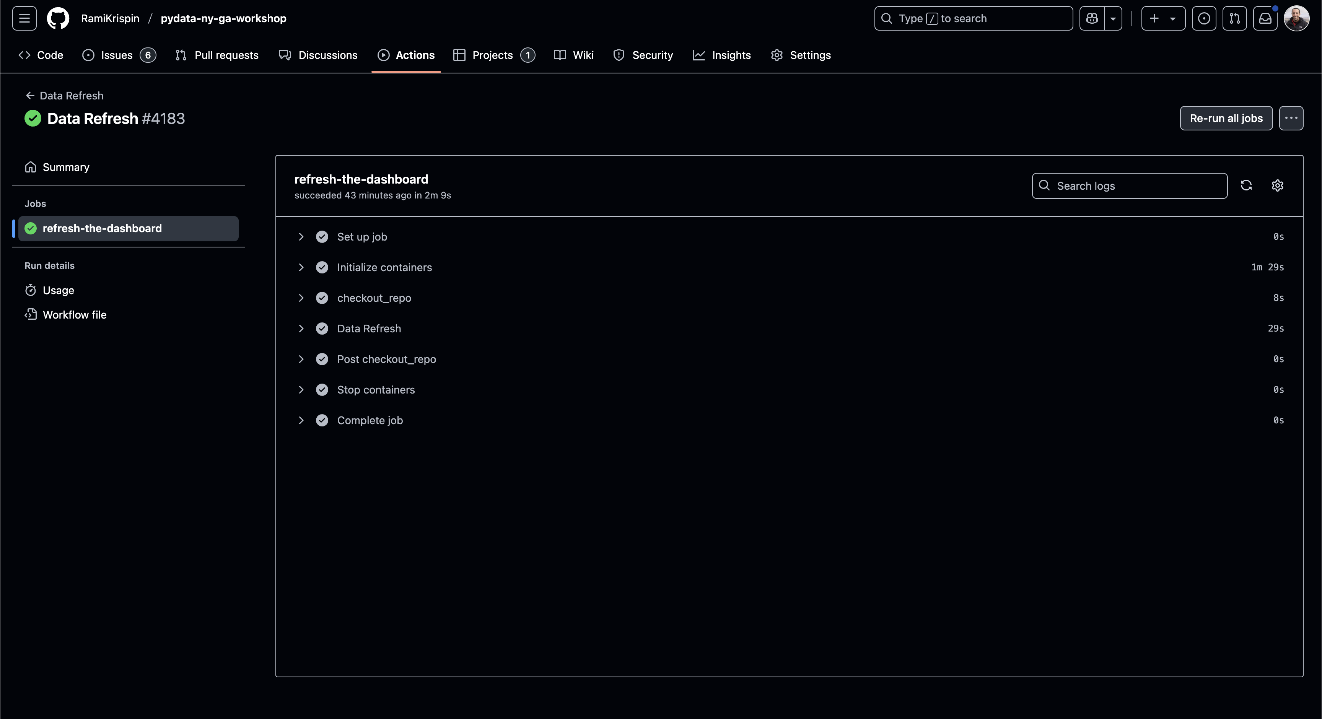
Data & ML Pipeline with GitHub Actions
Architecture
Remote Repository

Slide 62
Data & ML Pipeline with GitHub Actions
Summary
CI/CD platform
Out-of-the-box
Automate workflows
Deployment with Docker
Both free and enterprise versions

Slide 63
Questions?

Slide 64
Thank You!

